Slide 1

Design of Non-Volatile Latch using Resistive Memory Technology
ADVISOR: HAMID MAHMOODI
GROUP MENTOR: ALIYAR ATTARAN
MEMBERS: VLADISLAV MIFTAKHOV CODY DEL PRATO
SØREN TORNØE KWAN LIM
School of Engineering
San Francisco State University, San Francisco, CA
June 2017

Slide 2
Overview
STTRAM Technology, MTJ
Non-volatile (NV) Precharge latch
Read Operations
Write Operations
Research Goals: Optimization
Individual Transistor Sweeping
Full latch Optimization; Read, Write, Logic
Conclusion

Slide 3
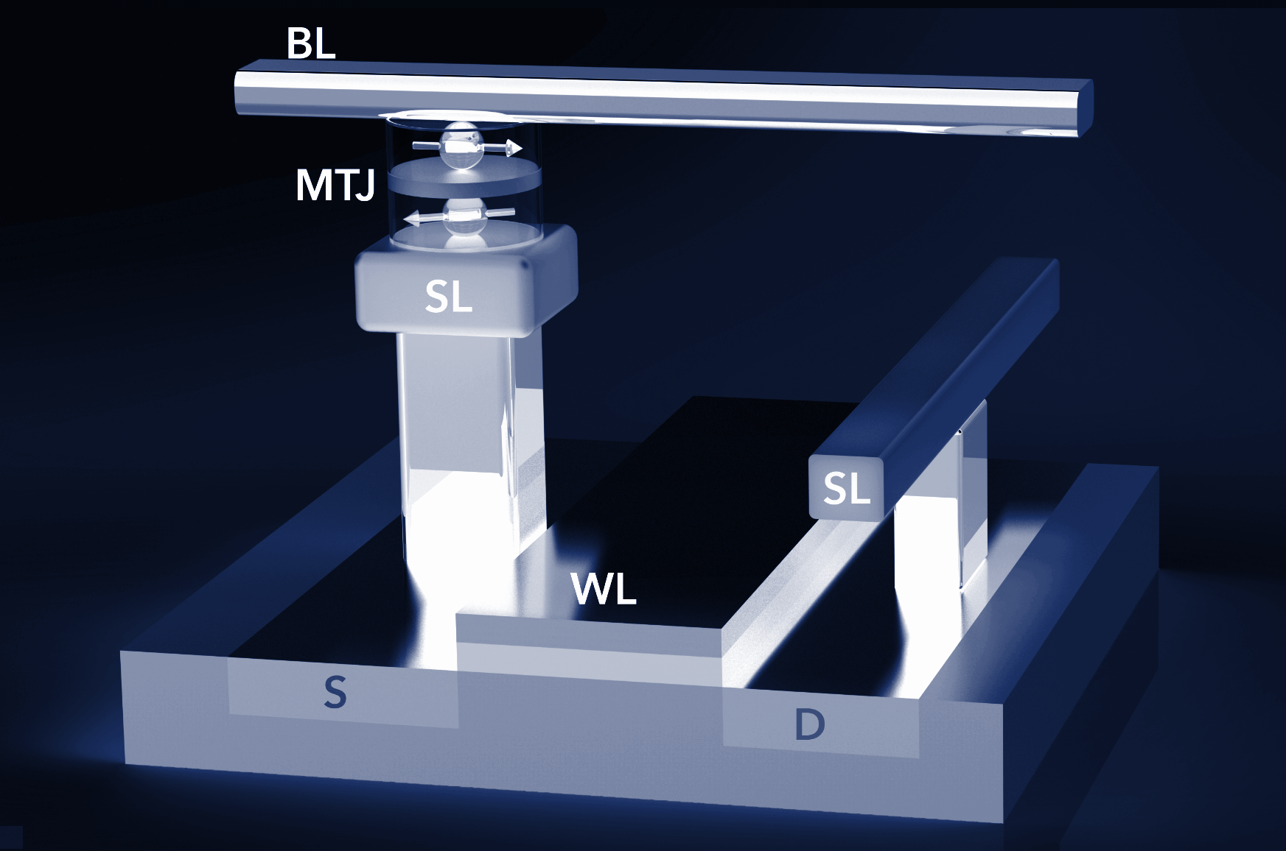
Spin Transfer Torque Random Access Memory (STTRAM)
Resistive memory technology to replace traditional charge-based memory.
Information storage by use of magnetic orientation
CMOS compatibility, scalability, non-volatility, low power
Cell consists of Access Transistor and Magnetic Tunnel Junction (MTJ)

Slide 4
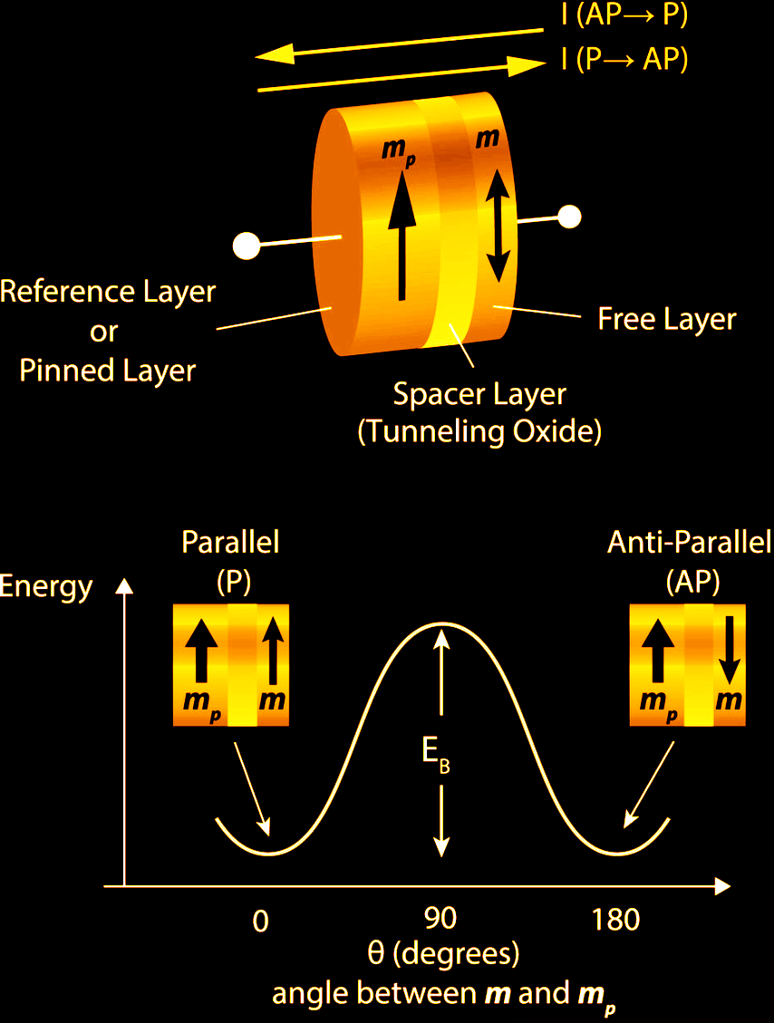
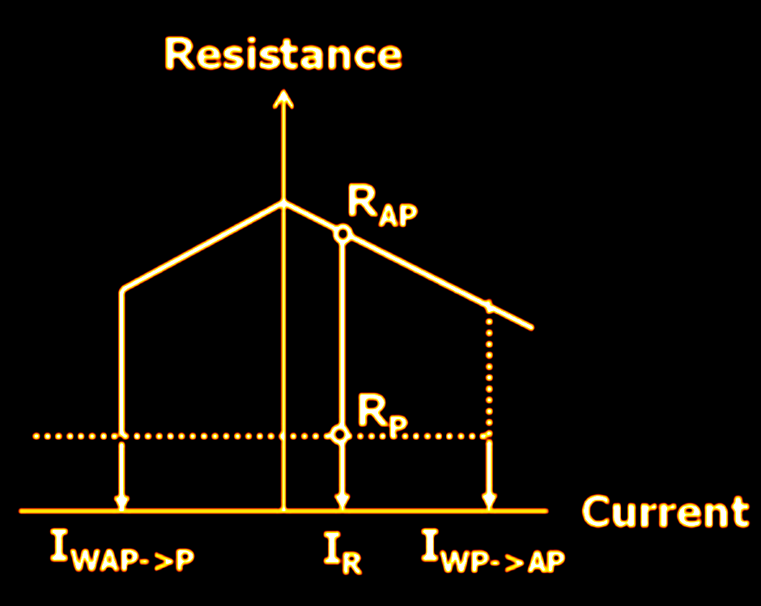
Magnetic Tunnel Junction (MTJ)
Composed of an oxide layer in between two ferromagnetic layers; one free and one pinned.
Information stored as high and low resistance; parallel and antiparallel states.

Slide 5
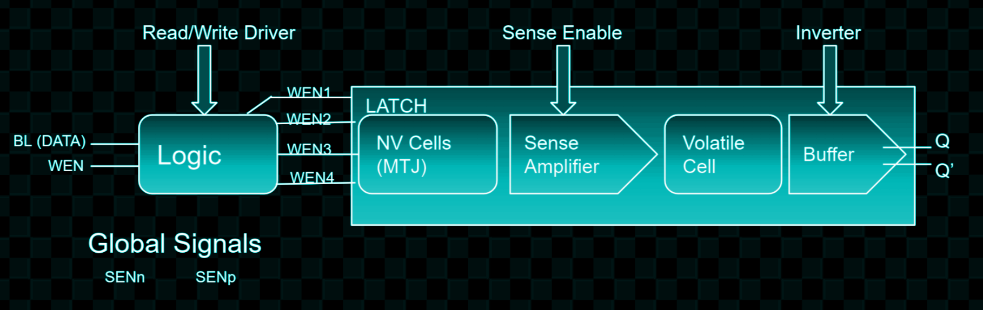
Non-Volatile (NV) Precharge latch
Non-Volatile MTJ cell stores data in resistive form
Write driver changes state of the NV cell
Based on state of non-volatile cell, Sense Amplifier sets the state of volatile cell; outputs Q and Q’
Two MTJs as differential resistive cells; latch acts as one-bit storage cell
Logic simplifies inputting signals for read and write operations.
Shared Read Control and Bit-lines

Slide 6
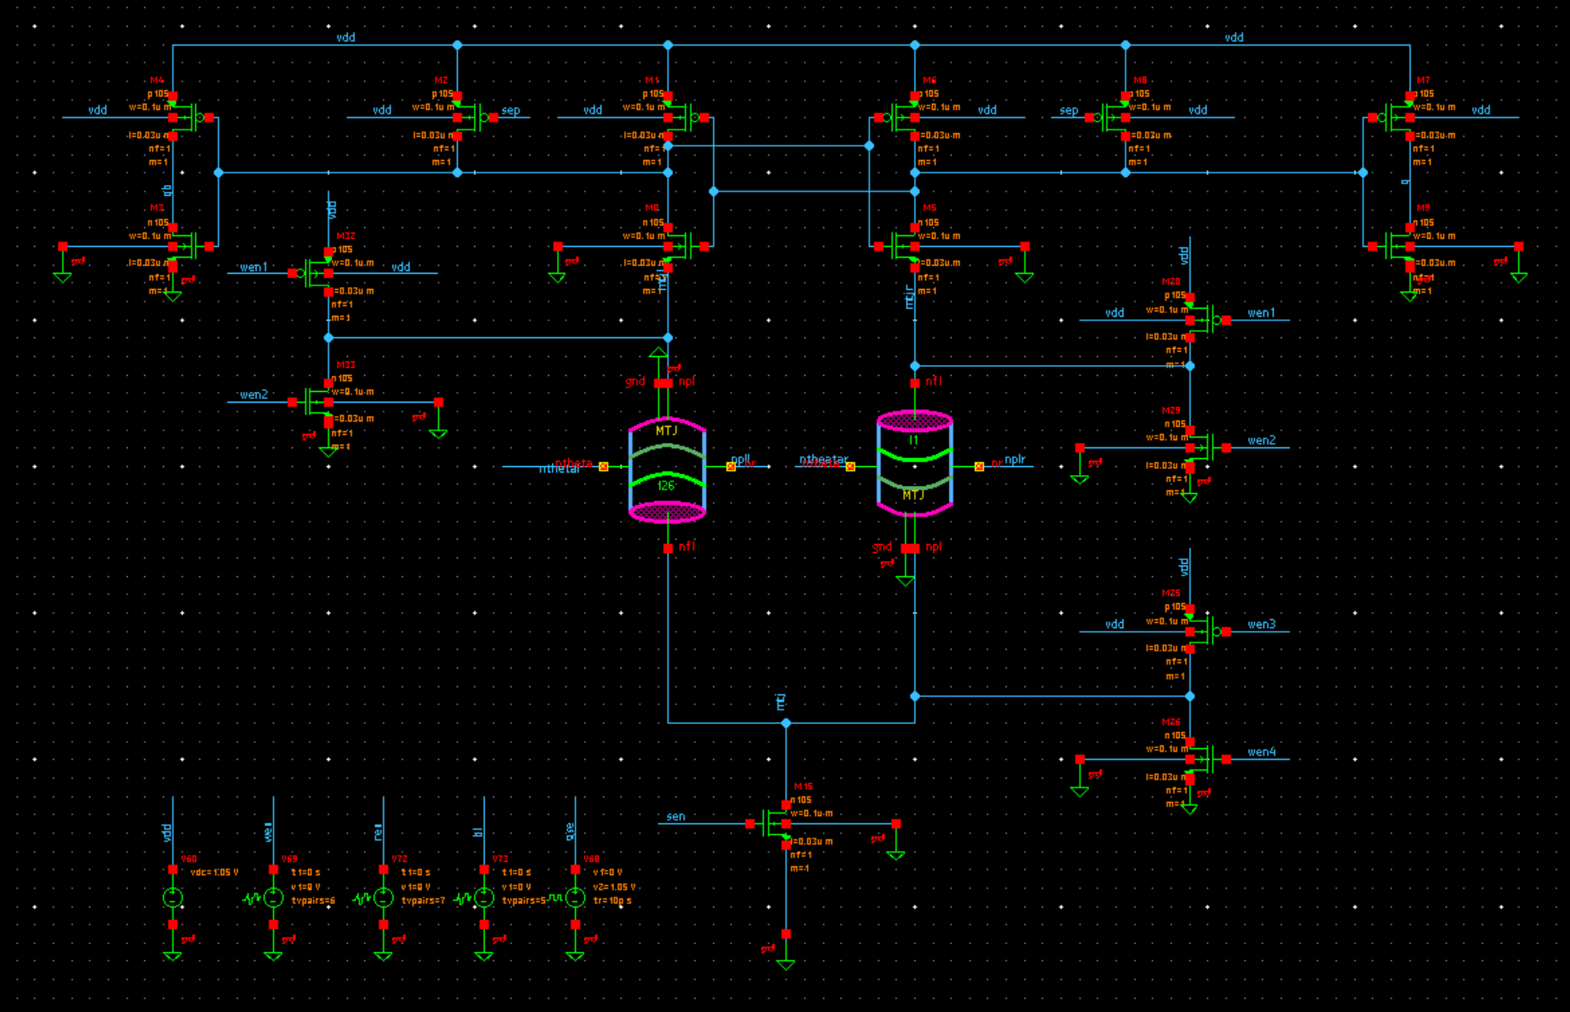




PreCharge Latch Schematic
SENSE AMPLIFIER/ READ TRANSISTORS
WRITE TRANSISTORS
MTJs
INPUT SIGNALS

Slide 7
Latch
Read: Based on delay
sense amplification to get q and q bar.
Write (first): Optimize write path for failure rate
tp is delay. delay goes up failure rate goes up.
See whether or not the MTJ gets flipped.
Perform failure rate simulations

Slide 8
Latch
There are two MTJs that act as resistive memory cells
Two read inputs and two read outputs
Four inputs for write
Individual transistors
Bottom most transistor is the Sense Enable while the top most section comprising of ten transistors placed to be symmetric down the middle is the Sense Amplifier.

Slide 9
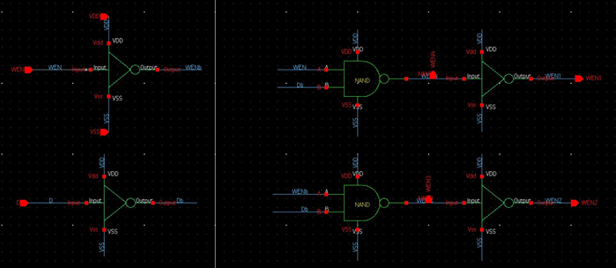
Control Logic Gates
Composed of Inverters and Gates
Input: ideal sources BL (Data) and WEN
Generates the signals to flip MTJ
Generates input signals to write and read

Slide 10
Control Logic Gates
Wen 1,2,3,4 in certain pattern to determine current (up to down or down to up).
Data | Wen | 1 | 2 | 3 | 4
0 | 0 | 1 | 0 | 1 | 0
0 | 1 | 1 | 1 | 0 | 0
1 | 0 | 1 | 0 | 1 | 0
1 | 1 | 0 | 0 | 1 | 1

Slide 11
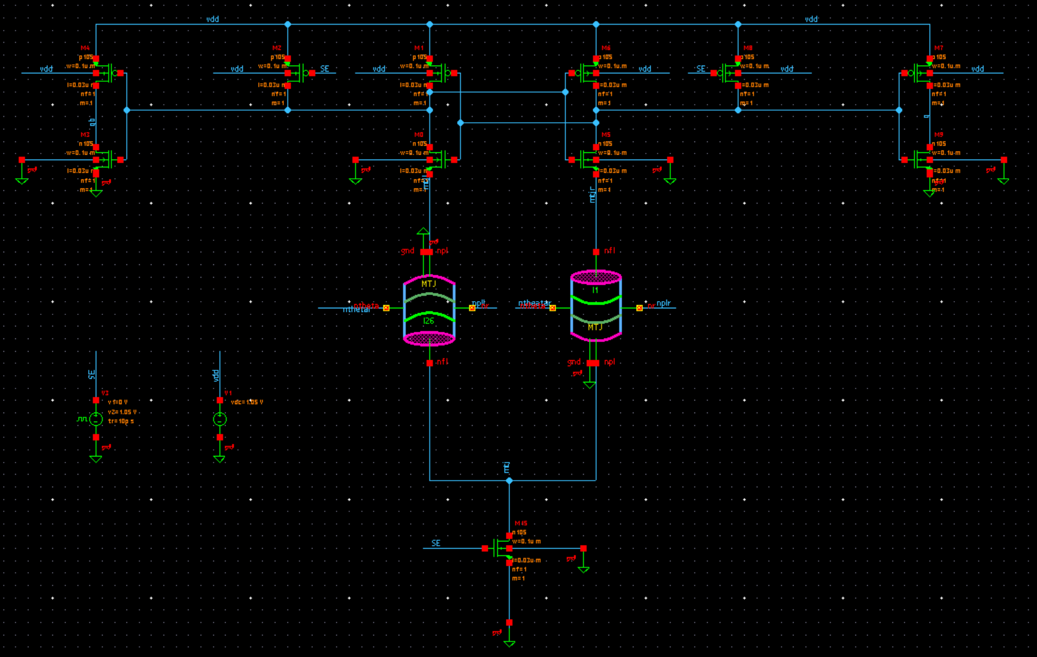
Read and Write Operations
READ

Slide 12
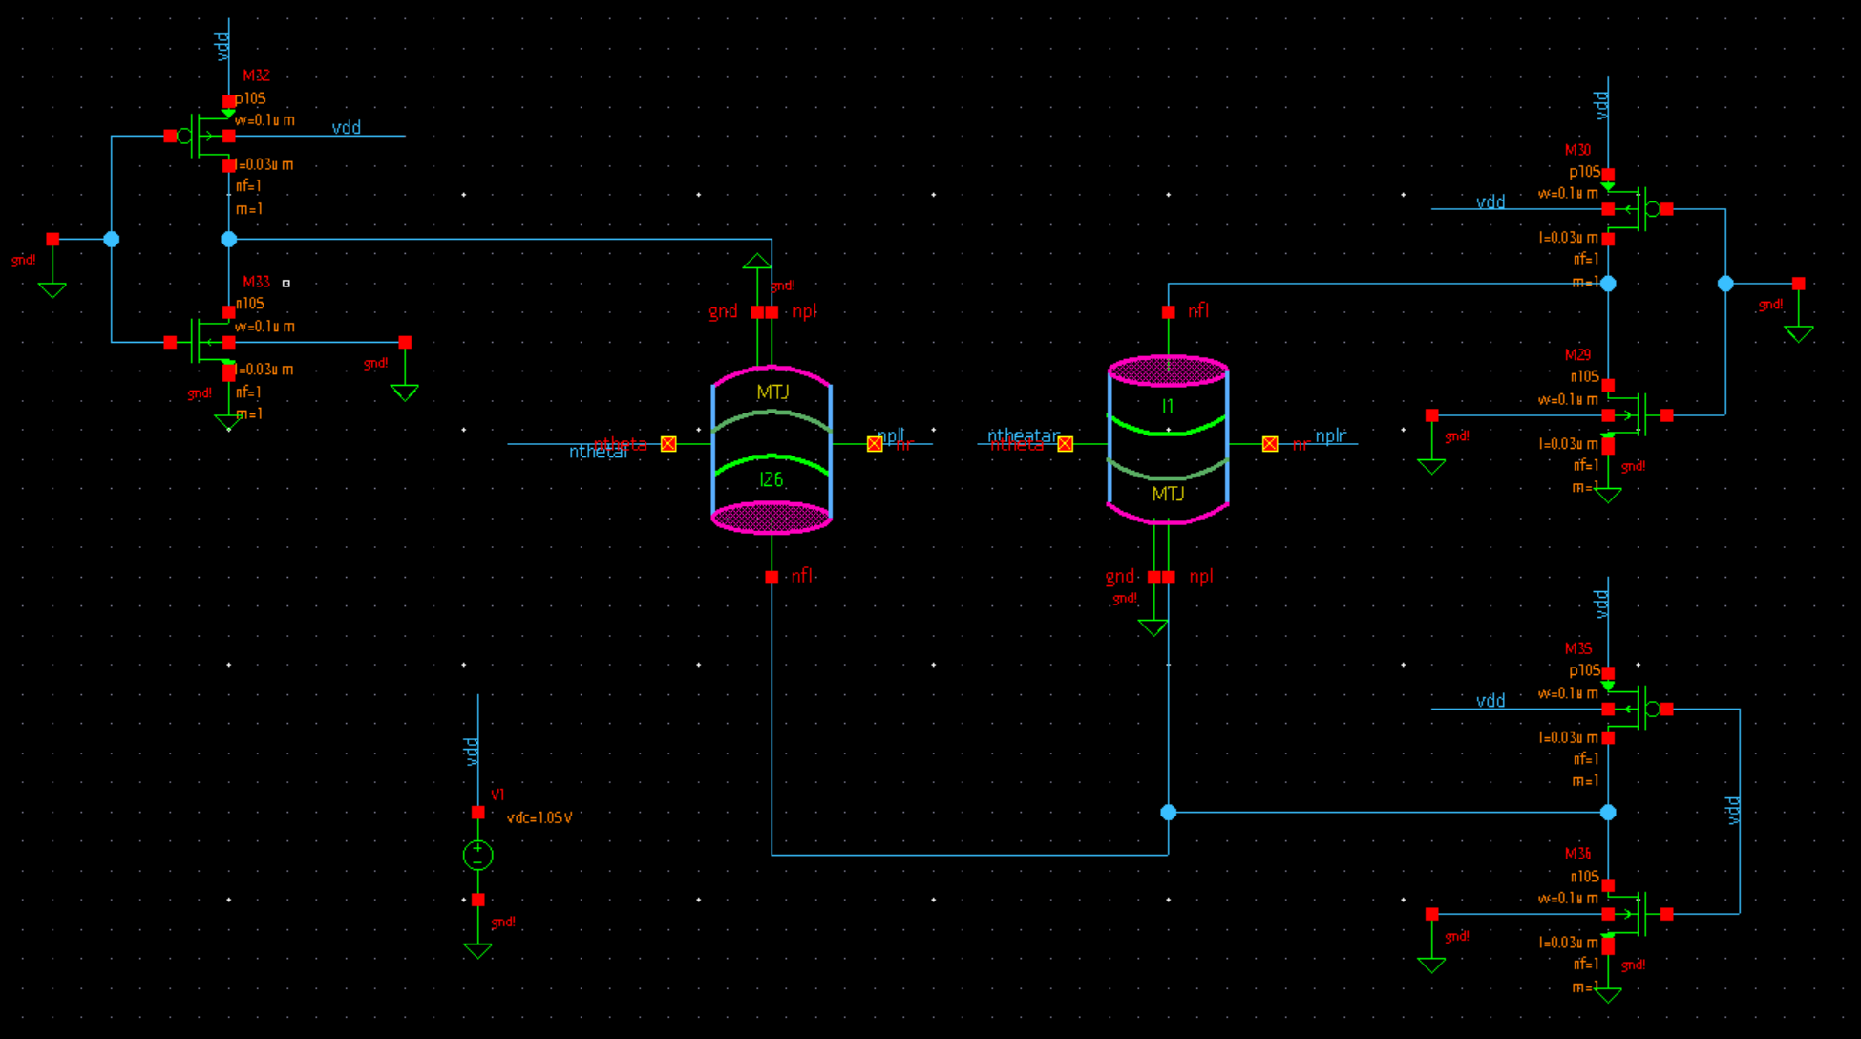
Read and Write Operations
WRITE (up to down) 1 0

Slide 13
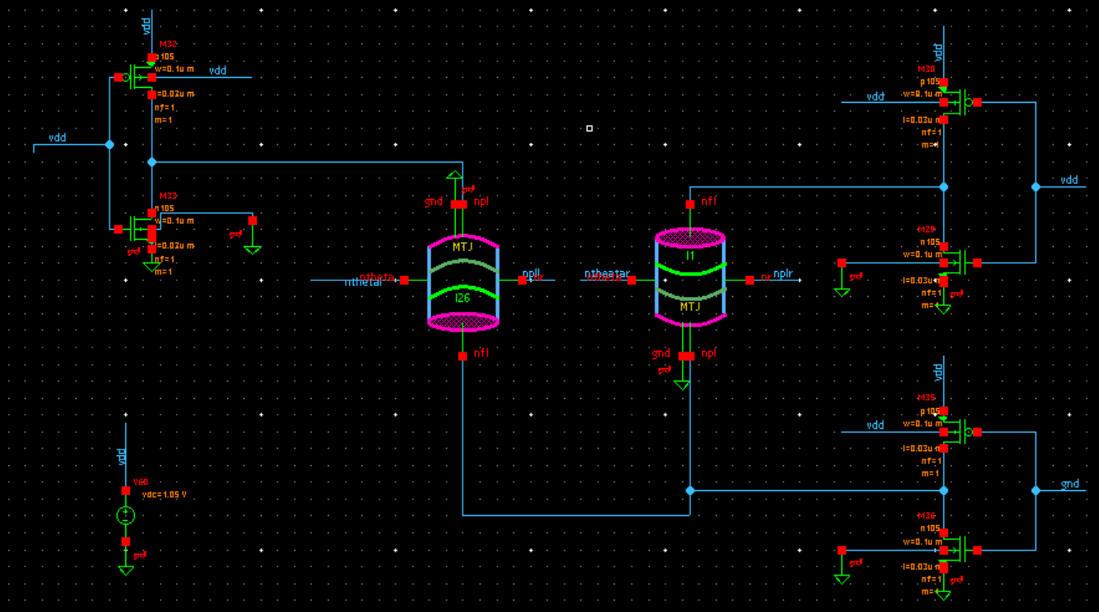
Read and Write Operations
WRITE (down to up) 0 1

Slide 14
Research Goals
Sweep Individual Transistors in Full Latch
Sweep Full Write Cycle
Write Cycle Optimization
Write Cycle Failure Rate Simulations
Sweep, Optimize, Simulate Read Cycle
Latch Layout

Slide 15
Delay and Area
Delay was measured as how long it takes for the MTJ to switch after current signal reaches it. Anything over 15 nanoseconds was considered failure.
In write operation, delay occurred whenever writing a value to the MTJs. Since there are only two operations we are looking at, write01 and write10, we only measured two delays. The maximum between these two was taken and is from here on referred to as just “delay”.
In read operation there are also two delays depending on whether the MTJs are oriented as 01 or 10.
Area is the summation of all transistor widths being tested.

Slide 16
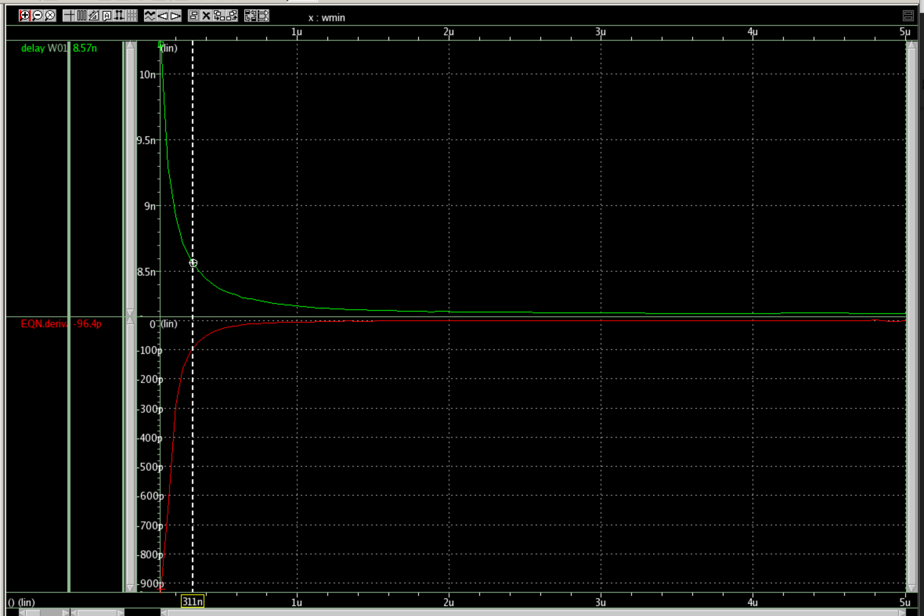
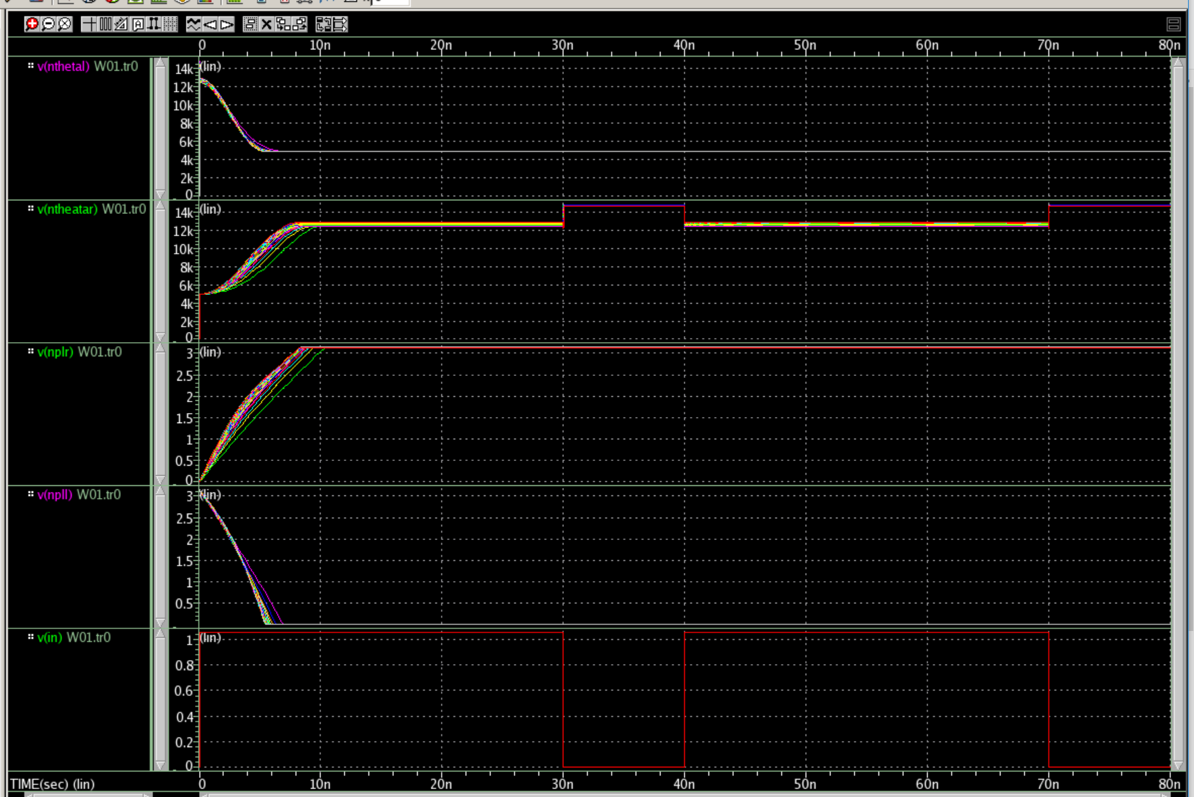
Individual Transistor Sweeping
Schematics exported as Netlist code
Swept width variable of each transistor individually to see trends in plot of delay versus width. All other latch transistors left at minimum size: .1 micrometers
Nonlinear Data
tr0 graphs show at which values write cycle fails
Delay meets saturation point; increase in width ceased to produce significant decrease in delay.

Slide 17
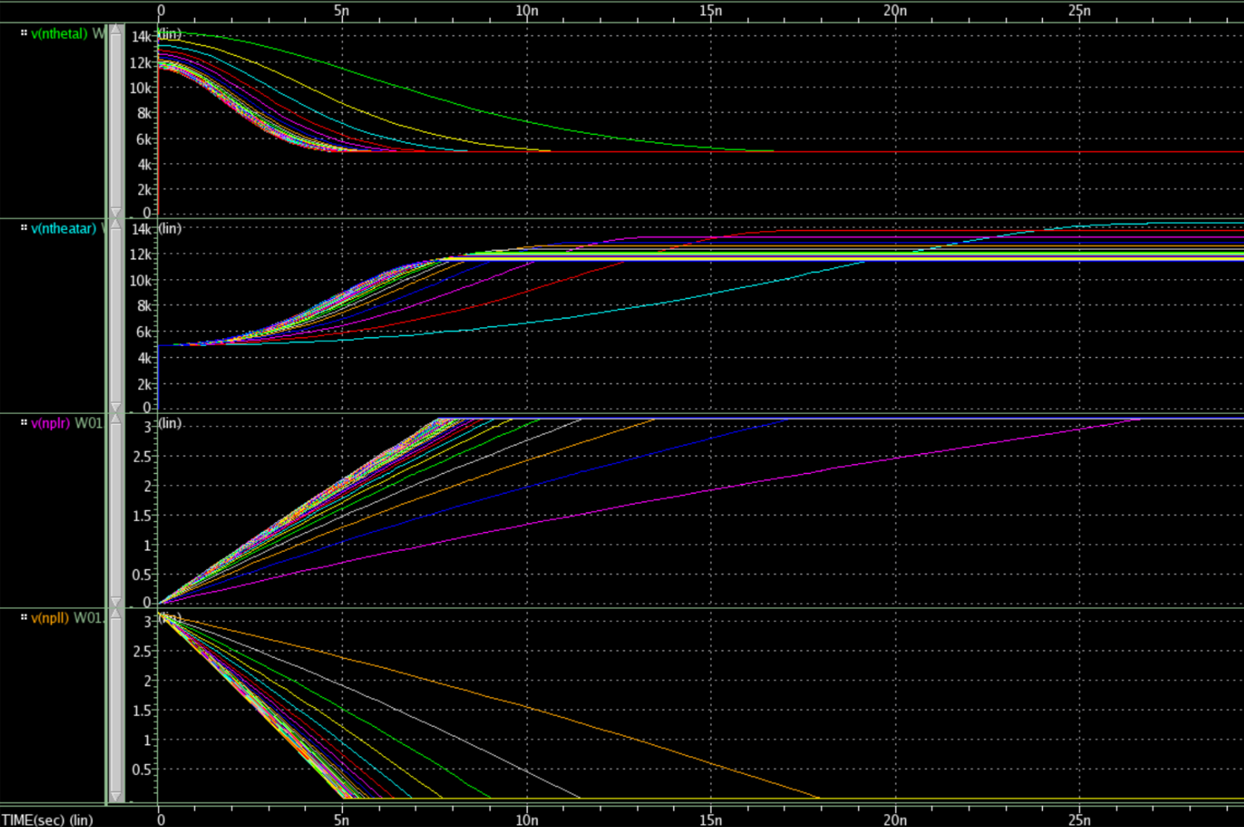
Individual Transistor Sweeping 2
Symmetry and sensitivity patterns: Pmos Transistors located at input signals SE and Nmos transistors located at output buffer of Sense Amp are least sensitive. These should be minimum size. Pmos of output buffer x2.55 times Nmos.
Symmetric transistors make up the sides of the Sense Amp and sides of top Write Cycle.
Most sensitive transistors and thus most likely to be large; m0 and m5, m1 and m6, m36, m35. m15 should be the largest

Slide 18
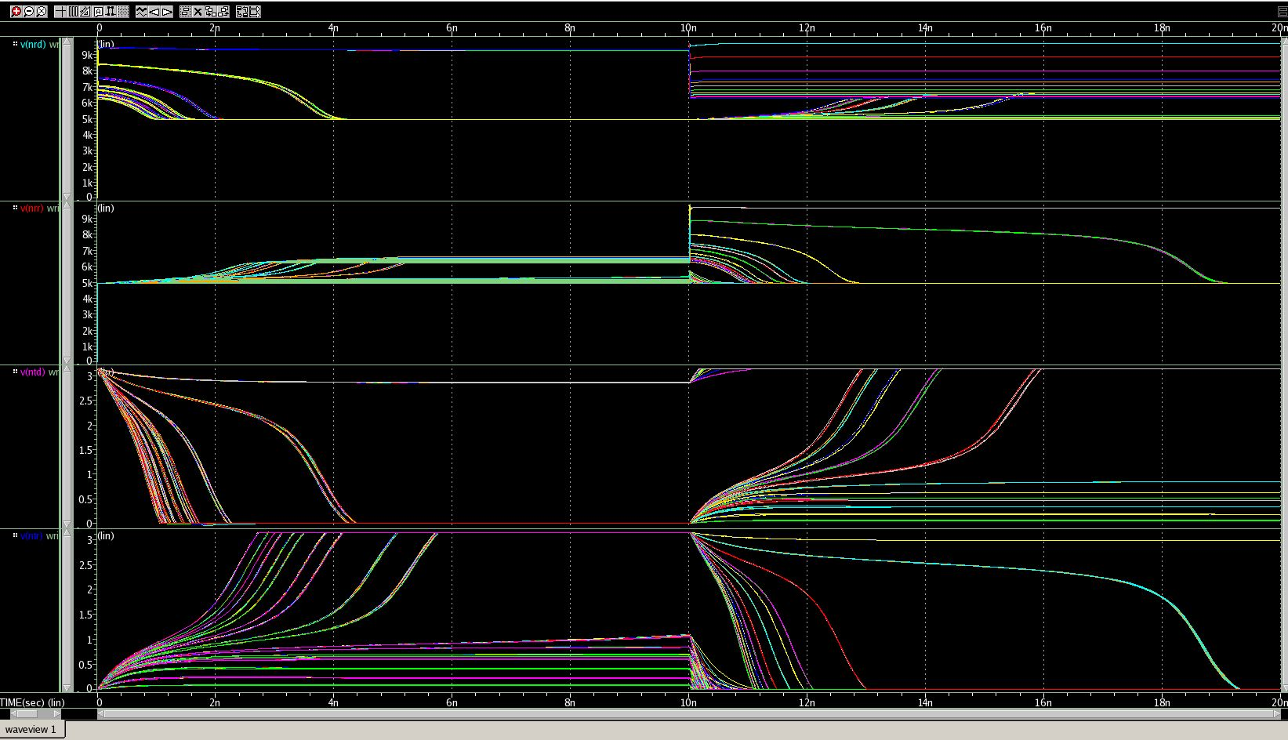
Full Sweep Write Cycle
6 transistors. Top symmetric: top nmos and pmos have same value, reducing total width variables to 4
Bottom nmos and pmos found dependent on top pmos and nmos, respectively
Variables in the full write sweep: topNmos, topPmos, ratio01, ratio10
Two ratios determine values of sinkPmos and sinkNmos
~10,000 combinations, results sorted in excel for further data analysis

Slide 19
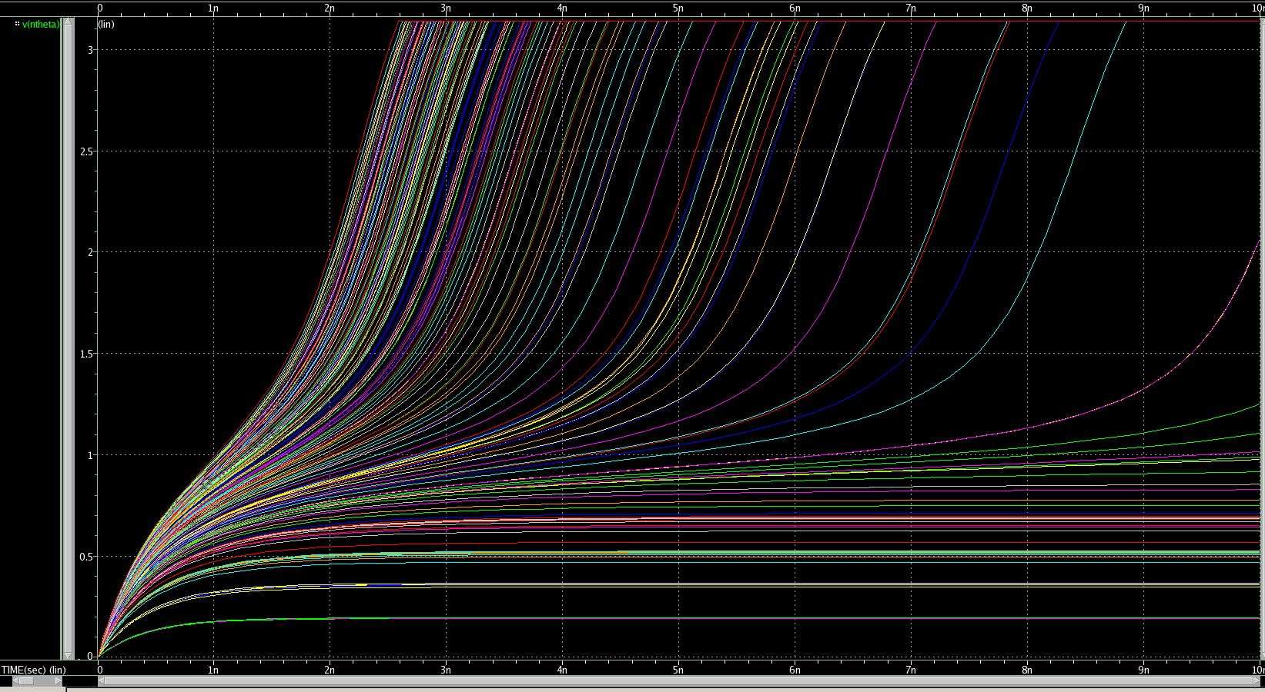
Full Sweep Write Cycle 2
Lowest delay no less than 2.42n. Correlated with largest area; 33+ micro
Minimum area without failure was 10u
All of the transistors had minimum values well above .1u
Data analysis of best runs: topNmos was consistently the smallest value width (under 2u), followed by topP (around 2.5u), sinkN (around 3u), and sinkP (around 4u)
Ranges better understood, tighter sweeps run
Made benchmark 3n

Slide 20
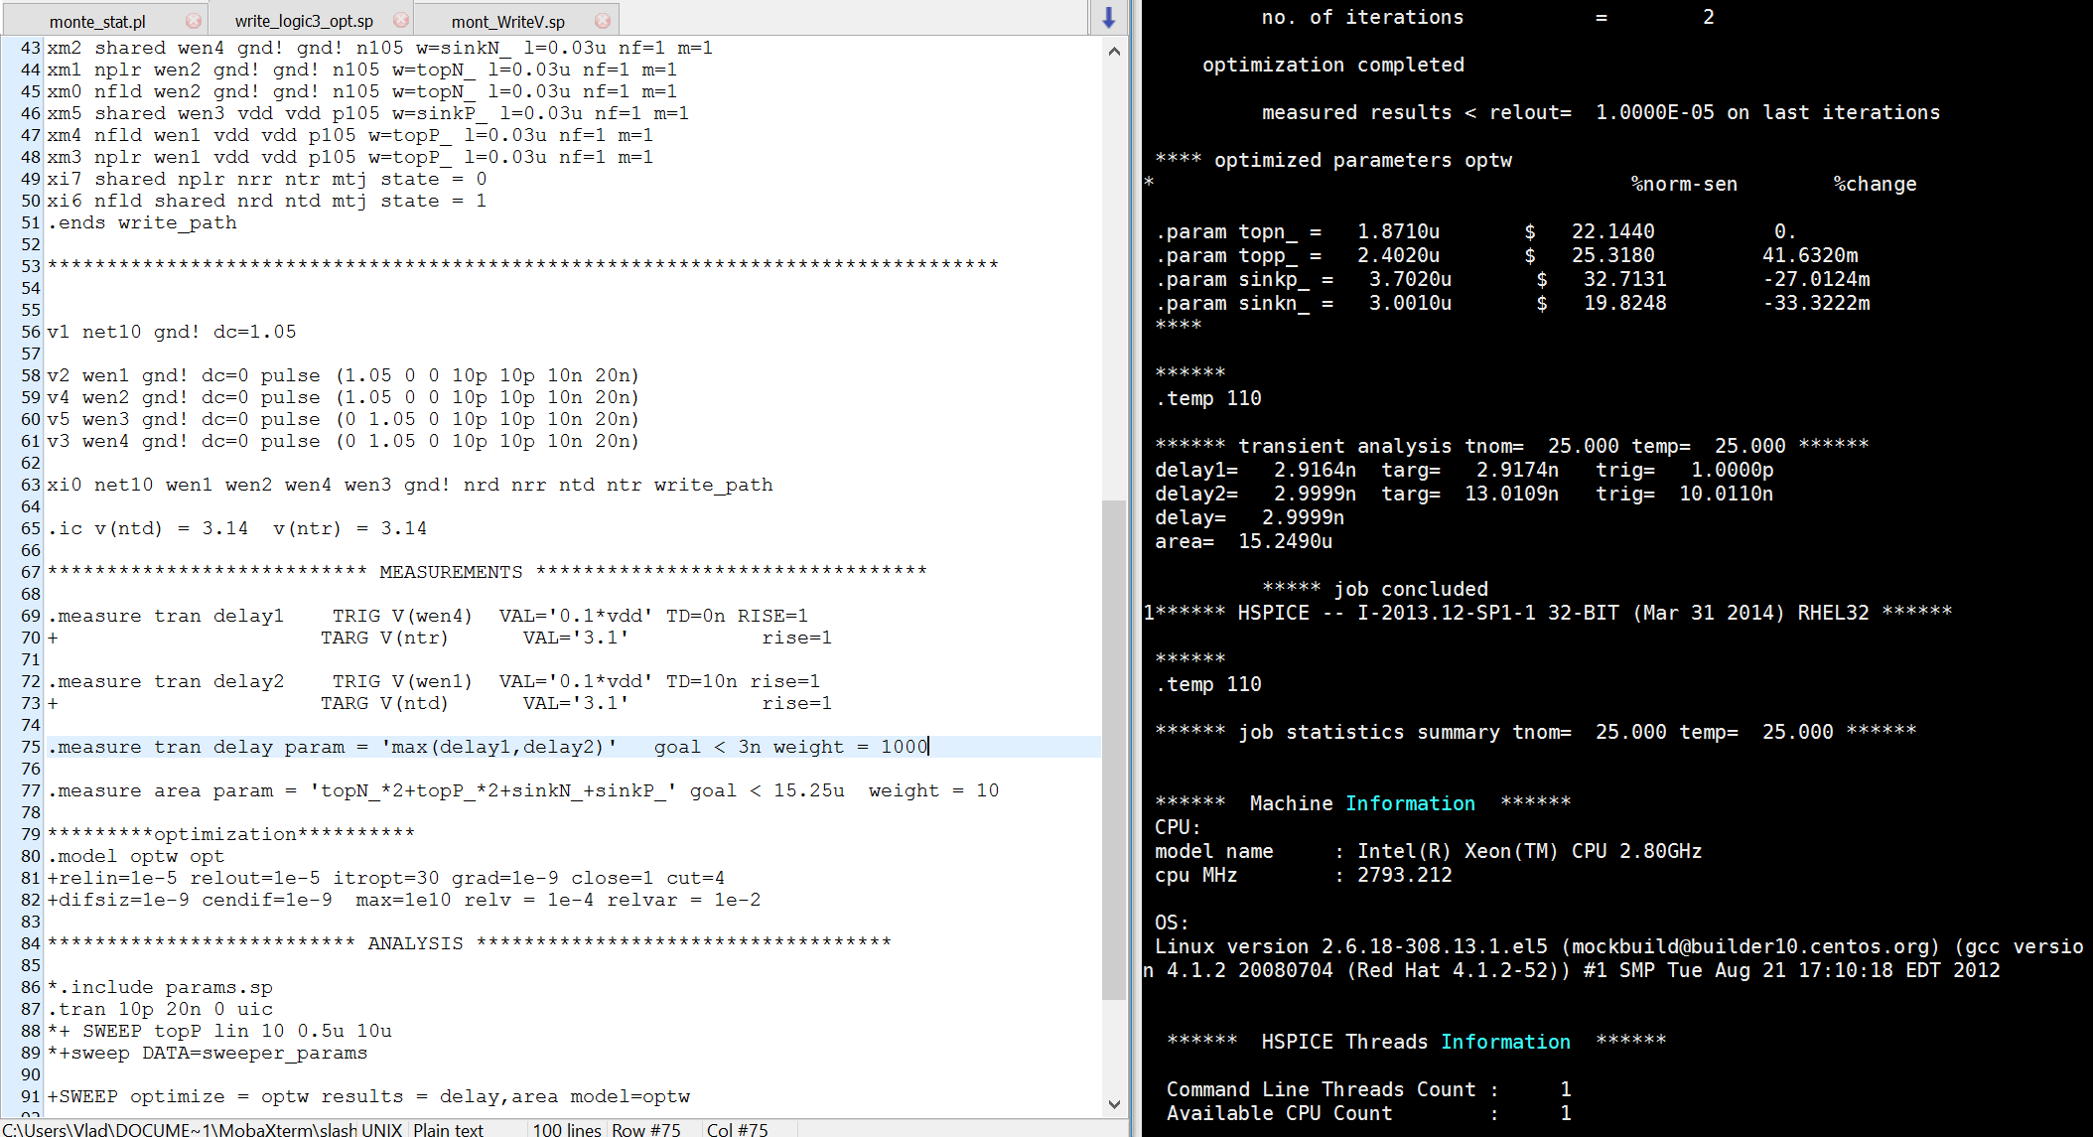
Write Cycle Optimization
Next task: find combination of transistors with least area while still operating at less than 3n delay
Close initial values picked to be run in optimization netlist for write cycle
Initial goals: less than 3n delay and less than 18u area.
Values outputted by the optimization program recorded for the final step; failure rate simulations.

Slide 21
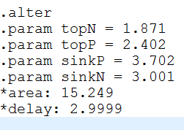
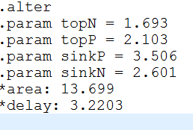
Write Cycle Failure Rate Simulations
A monte carlo failure rate netlist program was used to test each set of values 1000 times to ensure reliability of the circuit to within 0.1% accuracy. Also did 100 iteration runs.
Looked for values that passed the simulation with 0% failure rate, which meant at least 99.9% reliability for 1000 run.
1000 run: 100 run:

Slide 22
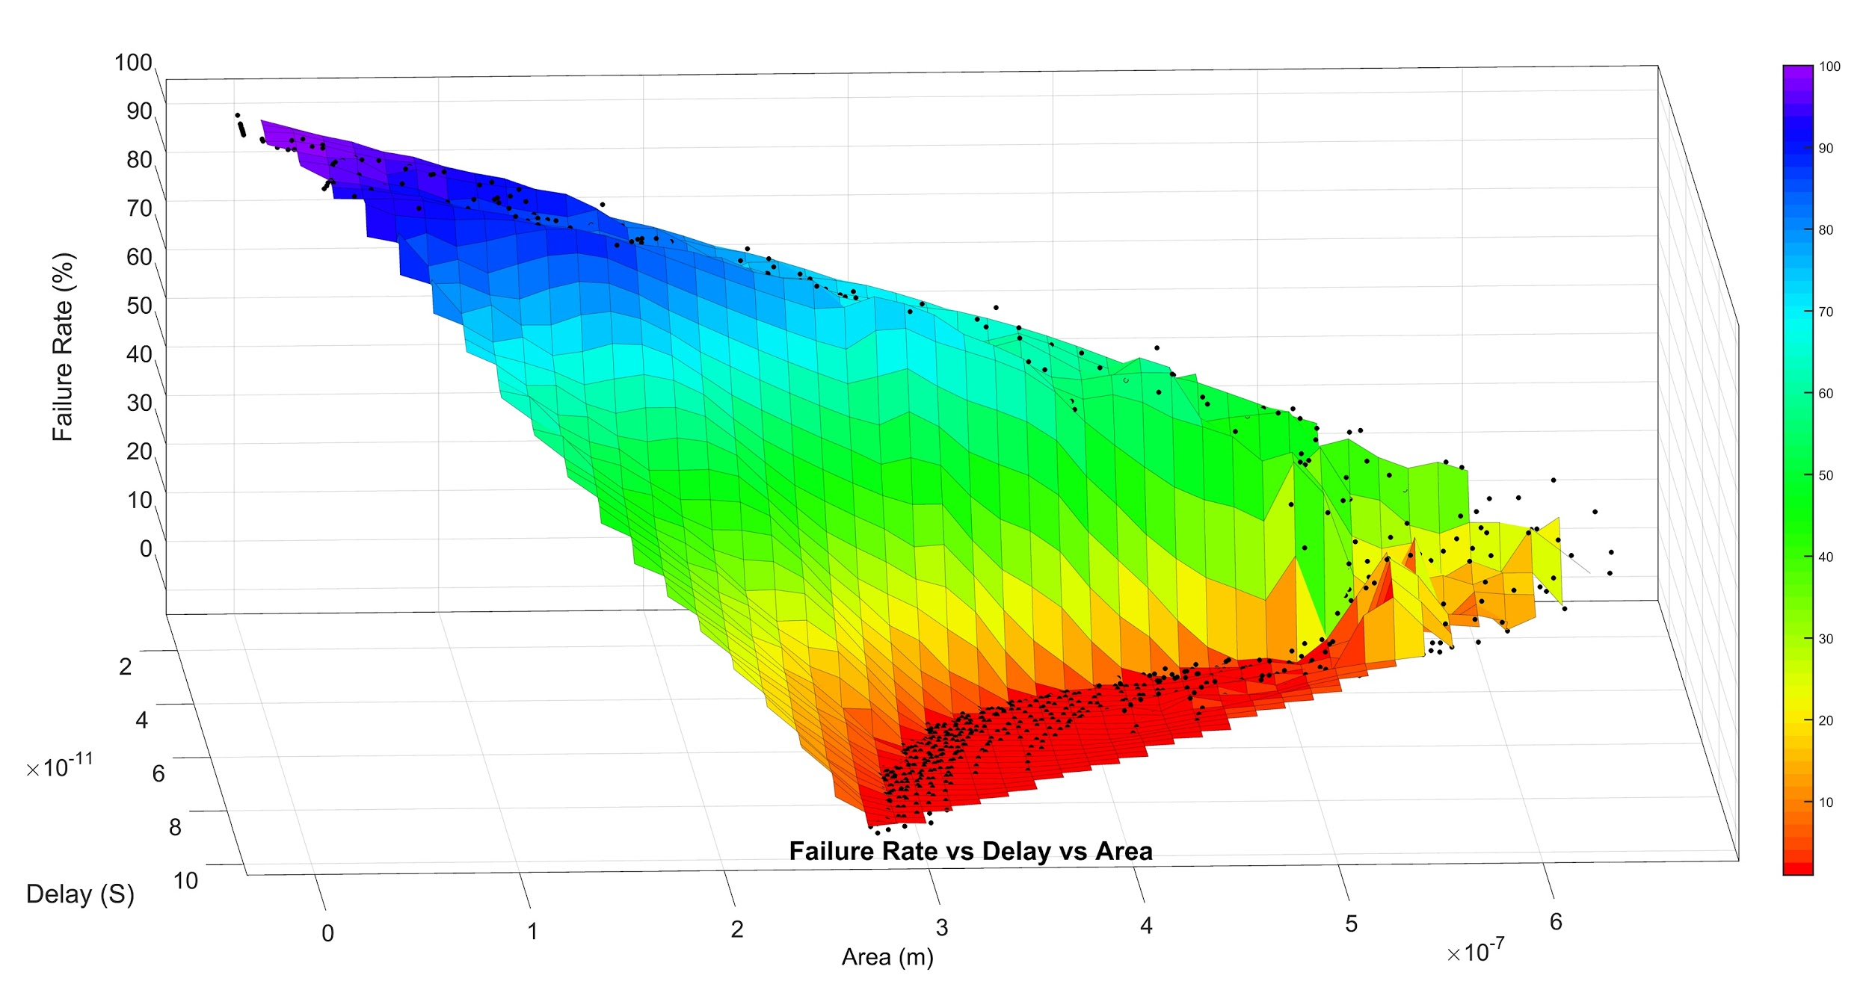

Slide 23
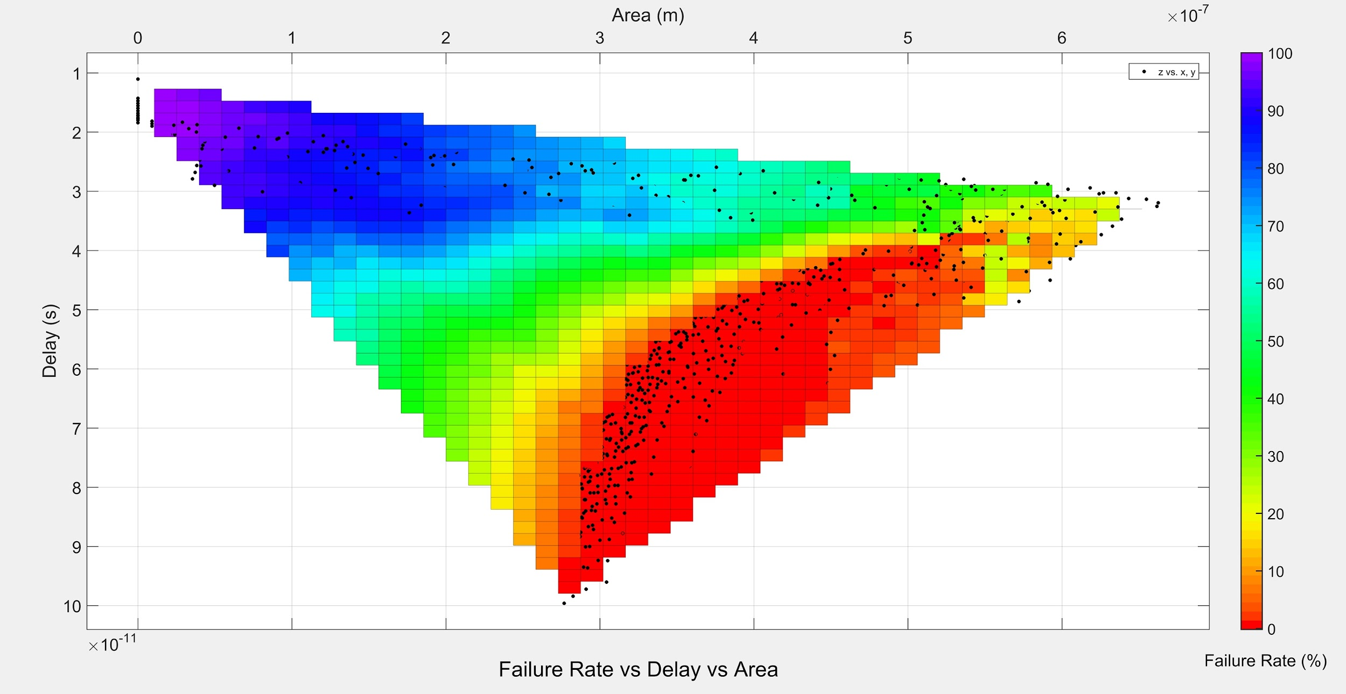

Slide 24
Sweeping vs Optimization Method
Compare them

